Slide 1
Cpts483 Intro to Robotics
Roslaunch
Instructor: Matt Taylor
TA: Faustino Lukolo

Slide 2
roslaunch
Advantages:
  Run everything all at once
  Reduce the number of open terminals
  Easily launch multiple ROS Nodes
  Allows the setting of parameters on Parameter Server
  Automatically re-spawn process which have died
  Can have one or more XML configuration files (.launch)
    Contains information about which nodes to launch and which parameters to set
    How nodes should be loaded

Slide 3
Using Roslaunch
Command :
  $ roslaunch [package_name] [filename.launch]
Creating a launch file:
  Open text editor
  Save the file in catkin workspace directory
    mimic.launch

Slide 4
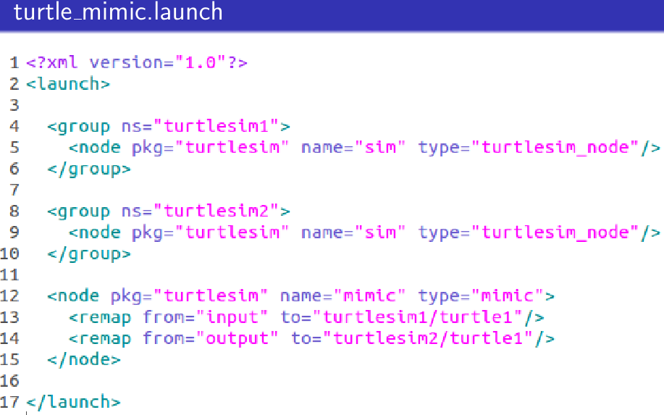
Creating Roslaunch
Open text editor and type the following

Slide 5
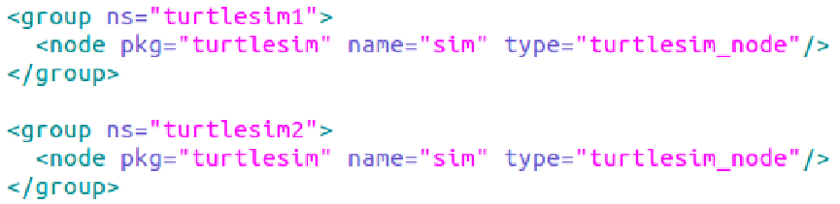
Exploring mimic.launch
launch files are writing in xml format
<?xml version = "1.0"> : Xml version to use
<launch> : start of launch file
Nodes are grouped into namespace each node has a unique namespace which will allow us to publish and subscribe to specific Node
e.g.
Note : Node definition begin with <node pkg= ….. / > it can also be modified to allow for extra parameters (later)
Here we create two namespace using turtlesim package
Each namespace has a node type turtlesim_node
Notice that everything is identical except for the namespaces

Slide 6
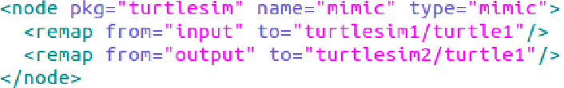
Exploring mimic.launch
Mimic node
Notice that the mimic Node does not need to be in a namespace because its main purpose is to remap the keys from turtle1 to turtle2 Nodes which are in the turtlesim1 and turtlesim2 namespaces.

Slide 7
Launching .launch files
Close all terminals (shutdown nodes and roscore)
$ cd [catkin workspace directory]
$ roslaunch turtle_mimic.launch
Note that roscore is running because roslaunch command runs roscore at run time

Slide 8
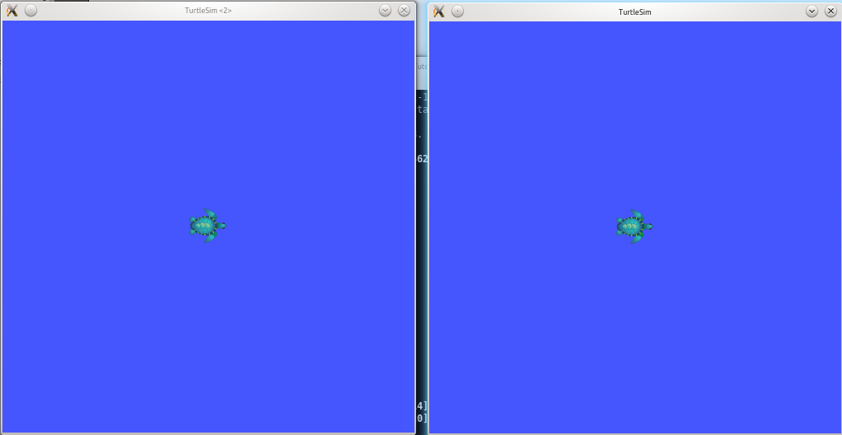
turtle_mimic.launch
The launch file contains definition for 2 turtlesim_nodes hence we have two window
Notice also that the name is the same for both windows

Slide 9
rqt_graph representation
Check which topics are advertised / subscribed
Try to publish message over /turtlesim/turtle1/cmd_vel topic
  e.g. $ rostopic pub -r /turtlesim1/turtle1/cmd_vel geometry_msgs/Twist '[x, y, z]' '[x, y, z]'
Computation Graph Representation should look similar to this

